Slide 1
Design Patterns
Chapter 3

Slide 2
OO Design Redux
Consider a GUI type named Window
  Unadorned, but functional
Now suppose we want some more full-featured windows
  Bordered, scrollable, etc.
How do we design this?

Slide 3
OO Design 101
A BorderedWindow is most assuredly a Window
  Sounds like an “is-a” to me!
Ditto ScrollableWindow
  Sort of obvious, no?

Slide 4
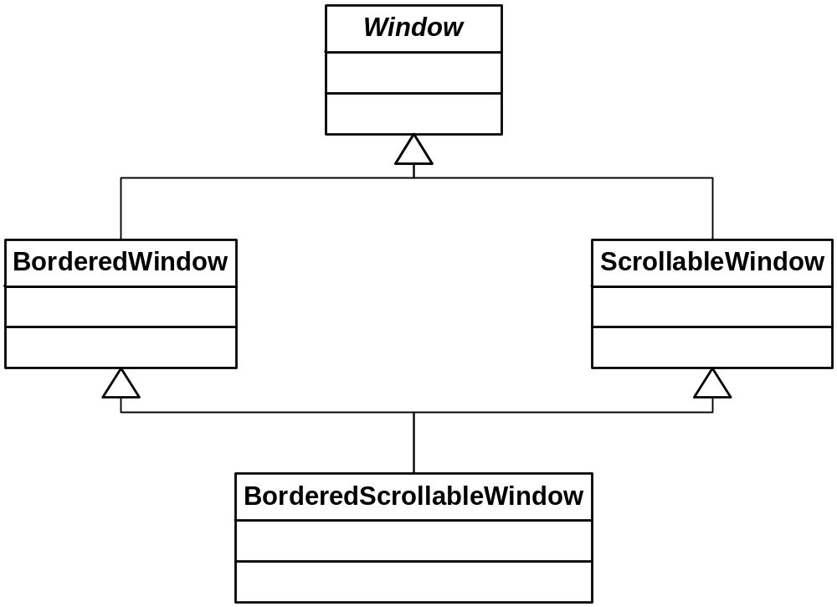
Our Simple Hierarchy

Slide 5
Counting Classes
Note that the number of classes is quite predictable:
  1 (= C(2,0)) for the root
  2 (= C(2,1)) for the single-featured subclasses
    2 features total, choosing 1 at a time
  1 (=C(2,2)) for the leaf
    Combines all features
Total of 4

Slide 6
Evaluating Our Design
Ignore details of multiple inheritance
  We can always work around that
Any other problems?

Slide 7
Problem #1
The subclasses have operations that the Window superclass doesn’t
  scroll, for example
  Not completely an “is-a”
    But it isn’t unusual for a subclass to add operations; no biggie
We could put these methods in Window
  But they’d be no-ops in the subclasses that don’t use them
  Someone isn’t encapsulating variation!

Slide 8
Problem #2
What if we need to add another important, independent windowing feature?
  WhizbangWindow
What impact does this have on the hierarchy?

Slide 9
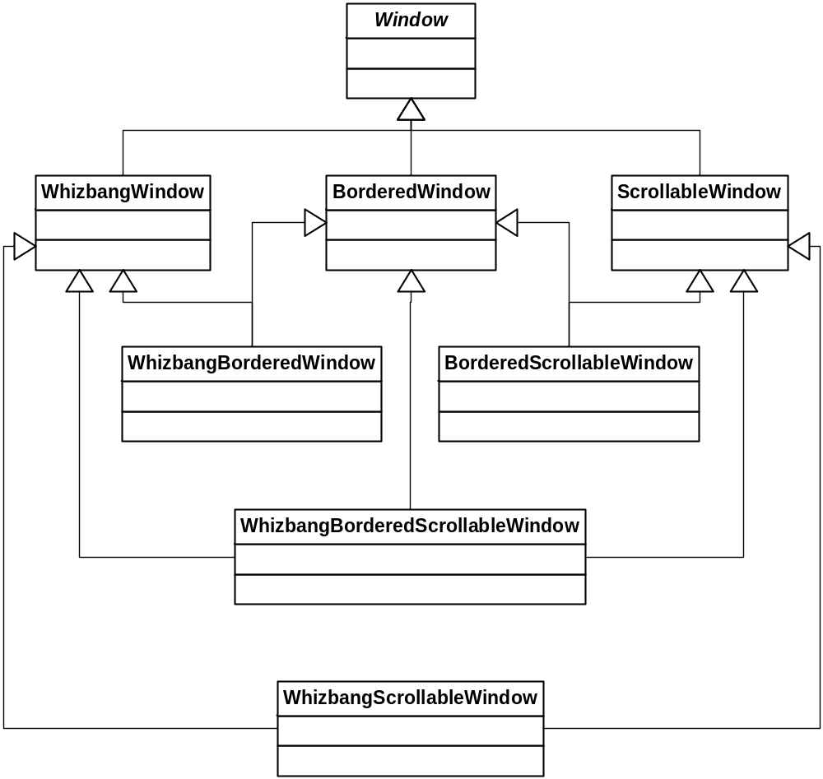
Hierarchical “Progress”

Slide 10
Definitely Counting Classes
1 (= C(3,0)) for the root
3 (= C(3,1)) for the first row
  Single-featured
3 (= C(3,2)) for the second “row”
  Double-featured
1 (= C(3,3)) for the leaf
  All three
Total of 8

Slide 11
Looking Ahead
C(n,0) + C(n,1) + … + C(n, n-1) + C(n, n)
Equals 2^{n}
Can anyone say “combinatorial explosion”?

Slide 12
An Alternative?
Maybe it would be better to avoid the inheritance web, and have a single level (broad) hierarchy
  It gets rid of MI!
  What do we lose?
How many classes are needed?
  The same number! No fewer!

Slide 13
Starbuzz Coffee
Has 4 concrete specializations of the Beverage type
  HouseBlend, DarkRoast, Decaf, Espresso
Also, there are four “features” that can adorn these drinks
  SteamedMilk, Soy, Mocha, WhippedMilk
64 clunky classes to look forward to! ( see page 81)

Slide 14
Principles???
Which of the design principles does this design violate?
  What happens if the price of milk goes up?
  What do they do when they add a new caramel topping?
  Separate what varies from what stays the same
  Favor Composition over Inheritance
  Maybe more!

Slide 15
Another Attempt
These “features” (condiments) really feel like attributes, don’t they?
So let’s just move them to Beverage
The concrete classes can compute the correct cost
  See next slide

Slide 16
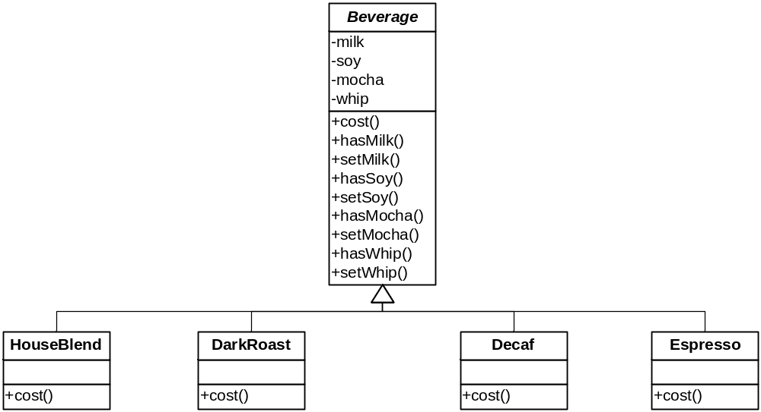
A Better Hierarchy?

Slide 17
Take #2, Calculating Cost
Write the code on page 83

Slide 18
Evaluating Take #2
Beverage.cost( ) must check for the presence of each condiment
As new condiments arrive, Beverage’s code must change noticeably
  New fields and methods, additional processing
We would rather be able to add new condiments without changing Beverage at all!
  “Separate what varies”
  At runtime! (Trivial in Smalltalk, Python, or Ruby)

Slide 19
Evaluating Take #2 continued
A new beverage may arrive that does not accommodate all condiments
  Who ever heard of mocha tea?
So we once again find ourselves removing functionality in a derived class
  Violates “is-a”
  Can result in repeated code
    As many no-ops will pop up

Slide 20
Designing for Change
What requirements or other factors might change that will impact this design?
(P. 84)

Slide 21
Inheritance -- Review
P. 85

Slide 22
The Open-Closed Principle
Classes should be open for extension but closed for modification
Say what?
It is better to extend a class by not changing its code
  Clients dependent on it will have to change
  New bugs can emerge
  We have seen how inheritance often violates this principle
  But there are other ways to extend classes!
    Composing a wrapper, for instance

Slide 23
Both Open and Closed???
P. 87

Slide 24
The Decorator Pattern
Structural
Intent:
  Add additional responsibilities to an object dynamically.
Context:
  Applies when clients program to an abstraction (not its subtypes). A decorator can be used in the same way as its subject (“is-a”). The set of additional responsibilities can be open-ended. Existing subject code does not change. Multiple decorators can be combined sequentially.
Solution:
  The Decorator implements the same interface as the abstraction. It manages a concrete instance of the abstraction via composition, and adds additional functionality. It calls the managed object’s methods and combines the result with the additional functionality.

Slide 25
The Decorator Pattern
Problem
  Write your version of a problem statement here…

Slide 26
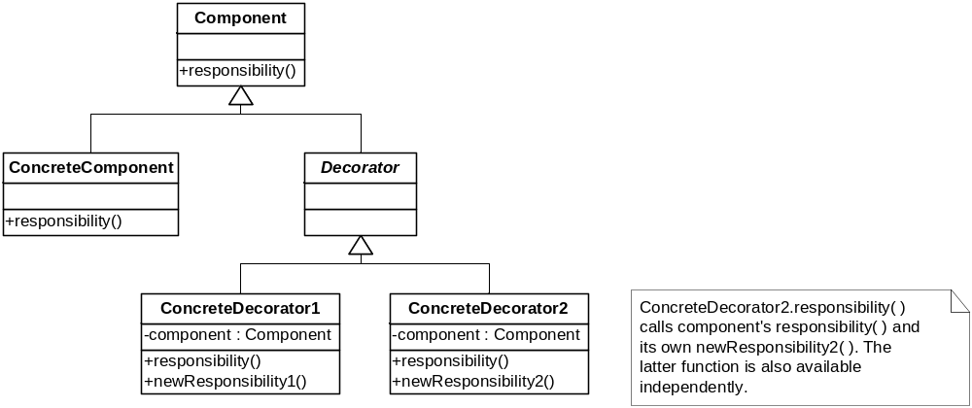
Class Sketch
⬅ Sometimes optional

Slide 27
Object Sketch

Slide 28
Decorators and Starbuzz
Suppose you want a DarkRoast Mocha Whip
The base component object is DarkRoast
You can wrap it in a Mocha decorator
  Or do Whip first, shouldn’t matter
Then wrap it in a Whip decorator
  Whip.cost( ) calls Mocha.cost( ) which calls DarkRoast.cost( )
  The total cost is accumulated and returned
The composite object can be used anywhere a Beverage can! (p. 88-89)

Slide 29
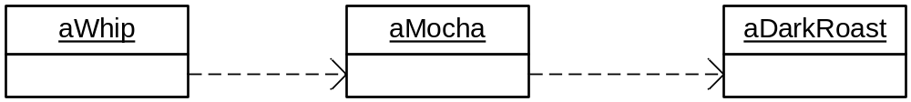
Decorators and StarBuzz
Object Sketch View

Slide 30
Dynamic Coffee!
Writing the code: P. 95-98
C++ example

Slide 31
No Dumb Questions
Page 99
Q1: What does this mean for adding Mocha to tea?
  You can’t forbid it easily
  If someone wants mocha in their tea, you have to let them do it – or change your design
  Or you could have CoffeeDecorators, TeaDecorators, and SoupDecorators
    Not so bad as long as there isn’t a great deal of overlap…
What if the condiments cost different depending on the type of beverage?
  The decorator could query the type of the object it surrounds
  Or you could have different types of Decorators
  Either way, it’s not ideal (you aren’t quite programming to the interface)

Slide 32
Inheritance vs. Composition
“Favor Composition over Inheritance”
Which does the Decorator use?
How does it support this principle?
P. 93

Slide 33
Condiments, Revisited
Couldn’t the coffee object simply have a list of Condiments?
  That’s composition, right?
In this case, yes.
  Other cases would not work well with a list of attributes
  See Program 3.

Slide 34
Different Sizes
P. 99
Supersize me!!!
What’s wrong with the solution presented in the book?

Slide 35
Variation #2
Suppose you want to find out what type of beverage you have, regardless of its condiments?
  I want to know if I have a Dark Roast or a Decaf…
Let’s try to implement that…

Slide 36
Variation #3
The description now prints:
  Dark Roast, Sugar, Milk
But if there are no condiments, how do I print:
  Dark Roast, Black
Let’s try it…

Slide 37
Variation #4
Our special this week is Dark Roast, so we give a 5% discount for condiments on a Dark Roast.
How do we do that?

Slide 38
More Variations
A decorator can add new methods
  Not the usual case
  Usually, it embellishes existing functionality
  But this is the case with Java’s I/O

Slide 39
Java’s I/O Layout
Several decorators add functionality to the stream and reader/writer classes
Example:
  readLine( ) is not in the superclasses
  It is added by BufferedInputStream and BufferedReader
See next slide

Slide 40
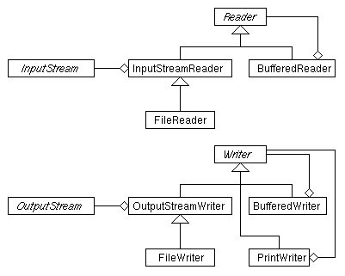
Java I/O

